Slide 1
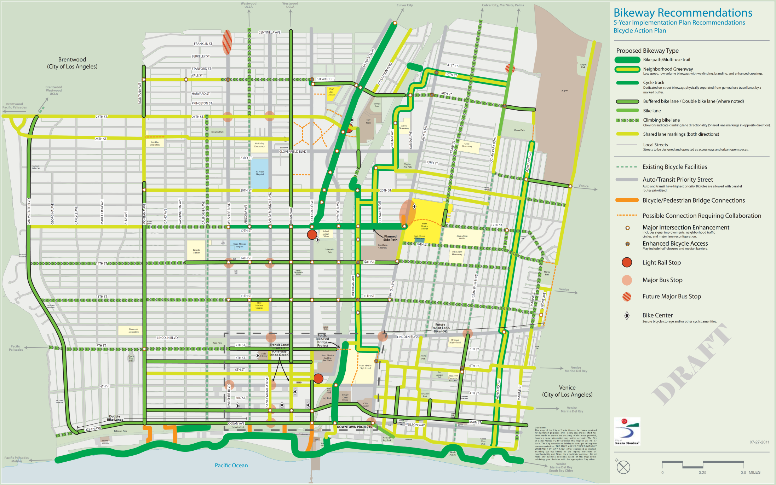
Bikeway Improvements – 2 year work effort
Improvements coordinated with
the annual Resurfacing/
Repaving project
Planning efforts that incorporate
bikeway improvements
Bergamot Area Plan
Interim Sharrows
Michigan Ave. Neighborhood Greenway
Downtown Access Improvements
Ocean Park Green Street Project
October 2011
Beach Path Striping and Signage Improvements

